Slide 1



Sean Lilley (Cesium / Bentley) Tamrat Belayneh (ESRI) 21 April 2026
OGC Code Sprint — London, May 2026
^{Pre-event webinar}​
3D Tiles 2.0 + glTF 2.1 Integration Track​

Slide 2
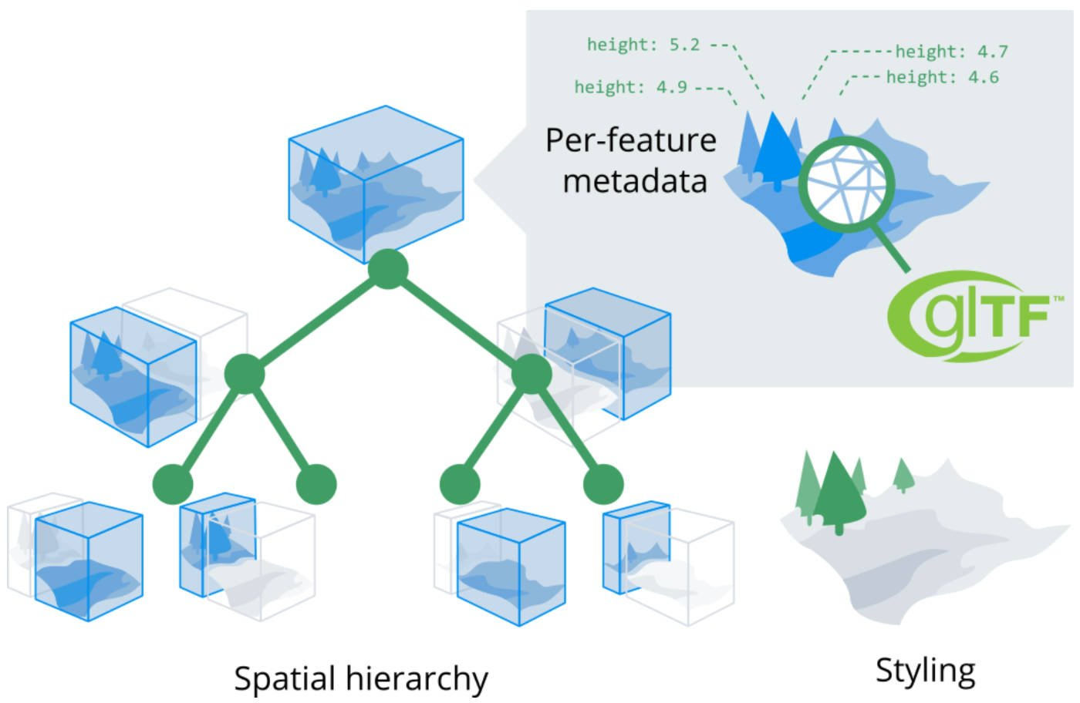
Background
3D Tiles has co-evolved with glTF
3D Tiles 1.0 - b3dm and i3dm formats wrapped binary glTF
3D Tiles 1.1 - glTF referenced directly as tile content
Many of the same concepts and goals
Designed for efficient transmission of 3D content
Scene graph and cartesian coordinate system
Trends
3D Tiles adoption outside geospatial
Desire to use glTF for complex scenes

Slide 3


Rebaselining 3D Tiles on glTF
Geospatial extensions
Region bounding volume
S2 tiling scheme
CRS / ellipsoid
2.1
Complex scenes
Bounding volume hierarchy
Level of detail
External glTF references
2.0
Assets
Geometry
Materials
Textures
Metadata

Slide 4
Sprint Goals
Bring together OGC and Khronos communities to advance the integration of 3DTiles 2.0 with glTF 2.1
Identify gaps in the current glTF 2.1 spec
Test compatibility with existing 3D Tiles and I3S implementations

Slide 5
Focus Areas
Coordinate Reference Systems — glTF 2.1 currently has no CRS support. Geospatial workflows require explicit spatial referencing (WGS 84, UTM, local CRS) for reprojection, multi-dataset composition, and GIS integration.
Level of Detail — The proposed LOD mechanism needs validation against real-world geospatial datasets to ensure it can express the refinement semantics (additive, replacement, screen-space error) that both 3D Tiles and I3S rely on.
Bounding Volume Hierarchies — Spatial indexing for frustum culling and intersection testing is foundational for geospatial streaming. The current BVH proposal needs schema development informed by production tiling implementations.
Structural Metadata — Per-feature attributes, typed schemas, and queryable statistics are essential for geospatial clients. The sprint will validate how existing metadata extensions map into glTF 2.1's new scene model.
Streaming Scalability — Production geospatial datasets contain hundreds of thousands to billions of nodes. The sprint will stress-test glTF 2.1's complex scene references at scale and billions of nodes. The sprint will stress-test glTF 2.1's complex scene references at scale and
Resource Bundling — There is a gap between single-file archives and loose file directories for efficient deployment. The sprint will prototype streamable binary bundles using glTF 2.1's new binary format and byte-range addressing primitives.
Domain Semantics — Typed scene layers (3D objects, buildings, point clouds, voxels) carry domain-specific meaning critical for AEC, urban planning, and infrastructure workflows. The sprint will evaluate how these semantics can be expressed in glTF 2.1.

Slide 6
Why Open Standards Participation Matters
The geospatial and 3D graphics ecosystems are converging — a once-in-a-decade alignment opportunity
Early engagement shapes specs before they harden
glTF 2.1 scope was locked January 2026. CRS, LOD, and BVH are still open for input. OGC members who engage now contribute as co-authors, not reviewers of a finished spec.
Production experience from both ecosystems makes better standards
3D Tiles and I3S have independently solved streaming, LOD, and metadata at scale. Bringing both perspectives into glTF 2.1 avoids re-learning hard lessons and reduces fragmentation.
Open standards lower barriers for the entire community
When geospatial semantics (CRS, attributes, domain types) become part of glTF core, every engine, tool, and platform benefits — not just geospatial vendors.
Cross-consortium alignment prevents duplication
Coordinated work across OGC, Khronos, and AOUSD ensures CRS, metadata, and scene composition are solved once and adopted everywhere — glTF, OpenUSD, and OpenXR.

Slide 7
Desired Outcomes
From the sprint:
Validated glTF 2.1 schemas for CRS, LOD, BVH, and structural metadata — tested against real-world geospatial datasets
Implementation feedback that directly informs 3D Tiles 2.0 before OGC vote
Documented rebaselining path for 3D Tiles 2.0 onto glTF 2.1 with compatibility considerations resolved or scoped
For the broader community:
Alignment between OGC and Khronos on how geospatial semantics map into glTF core
Harmonization with parallel efforts: AOUSD GeospatialAPI (CRS in OpenUSD), OpenXR spatial anchoring, cloud-native geospatial formats
Lowered barrier to early adoption — developers get hands-on experience with new schemas in a supported, collaborative environment

